Slide 1
Deep Level Transient Spectrometer-DLTS
Yuch Tian
ECE 658-Semiconductor characterization

Slide 2
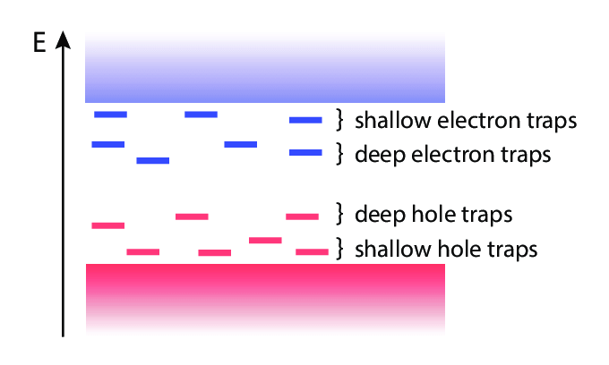
Shallow & Deep level
Impurity
Lattice defect
Surface/Interface state
Structural disorder
Thermal fluctuation
Coupling effect
[1] Kubyshkina, Elena. (2018). Ab initio modelling of interfaces in nanocomposites for high voltage insulation.

Slide 3
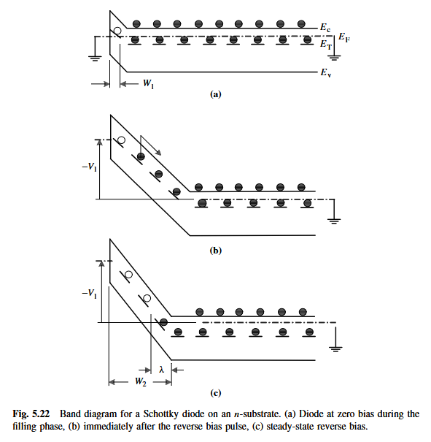
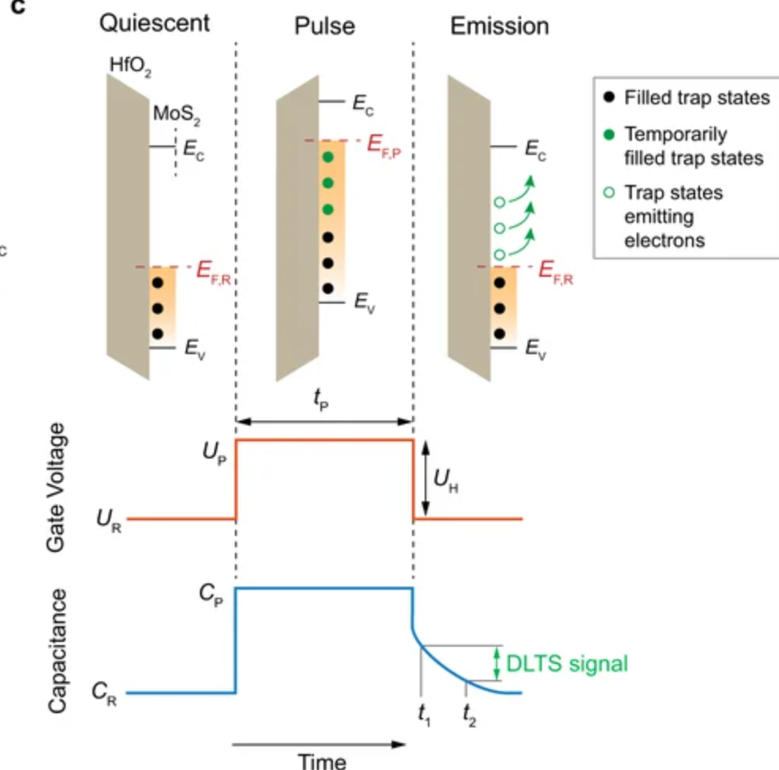
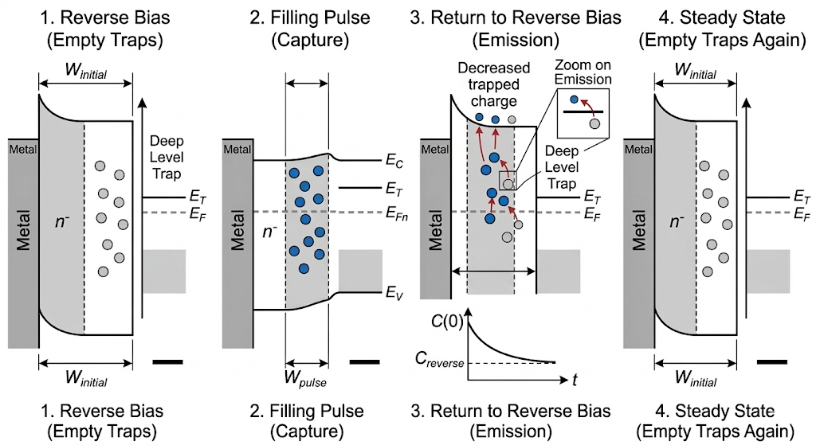
DLTS mechanism-boxcar DLTS
Step 1: Reverse bias creates a depletion region (traps empty).
Step 2: A pulse floods the region with carriers (traps fill).
Step 3: Bias is restored, and carriers thermally emit out of the traps over time.
[1] Kubyshkina, Elena. (2018). Ab initio modelling of interfaces in nanocomposites for high voltage insulation.

Slide 4
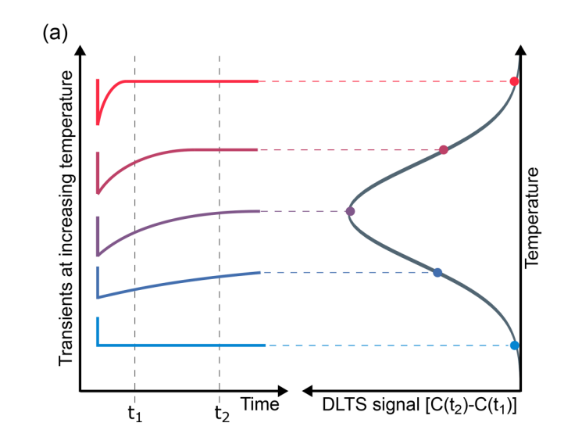

DLTS signal
Rate window (t1-t2)
Temperature sweeping
[3] Amanda Langørgen, Lasse Vines, Ymir Kalmann Frodason; Perspective on electrically active defects in - from deep-level transient spectroscopy and first-principles calculations. J. Appl. Phys. 21 May 2024; 135 (19): 195702. https://doi.org/10.1063/5.0205950

Slide 5
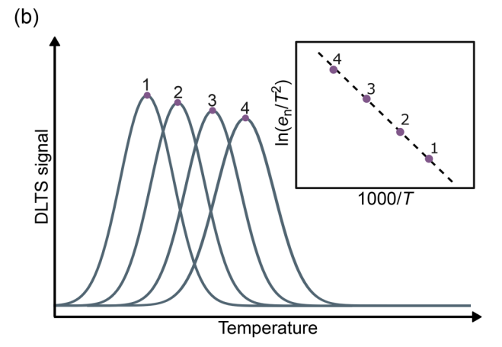
DLTS data analysis-Arrhenius plot
Activation Energy: How "deep" the trap is in the bandgap.
Trap Concentration: How many defects are present (peak height).
Capture Cross-Section: The probability of the trap catching a carrier.
[3] Kubyshkina, Elena. (2018). Ab initio modelling of interfaces in nanocomposites for high voltage insulation.

Slide 6
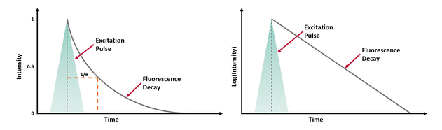
Type of DLTS
Scanning DLTS,Optical DLTS,Laplace DLTS
[3] Kubyshkina, Elena. (2018). Ab initio modelling of interfaces in nanocomposites for high voltage insulation.

